Slide 1
Predicting California Housing Prices
utilizing machine learning algorithms
Presented by: Md Ashiq Mahmood, Cassidy Norkett, Borsha Podder, Lawrence Tai

Slide 2
Objective
Data Understanding and Exploration: Gain insights into the dataset structure, characteristics, and relationships between features.
Data Preprocessing and Cleaning: Prepare the dataset for machine learning models by addressing missing values, scaling numeric features, and encoding categorical variables.
Building Predictive Models: Develop machine learning models to predict median house values based on input features.
Model Evaluation: Evaluate models using metrics like Mean Squared Error (MSE) and R² Score as well as performing cross-validation for the Random Forest model to ensure generalization and robustness.
Insights and Visualization: Using Correlation heatmap to highlight feature relationships, Scatter plot of actual vs. predicted values to evaluate prediction quality and Residual plot to analyze model errors and identify areas for improvement.
Comparison of Models: Comparing Linear Regression and Random Forest Regression to determine the best-performing model.
Notes:
Data Understanding and Exploration
Summarize key statistics to identify trends and patterns in housing data.
Visualize correlations among features to identify potential predictors for the target variable (median_house_value).
Building Predictive Models
Baseline Model: Use Linear Regression to establish a simple predictive baseline.
Advanced Model: Employ Random Forest Regression to capture complex, non-linear relationships.

Slide 3
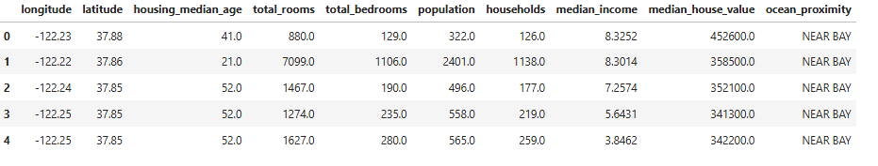
Dataset Overview
Dataset: California Housing Prices (10 variables –
20640 observations)​
Dataset Source: https://www.kaggle.com/datasets/camnugent/california-housing-prices?resource=download

Slide 4
Description of Data
Attribute | Description
Longitude | A measure of how far west a house is; a higher value is farther west
latitude | A measure of how far north a house is; a higher value is farther north
housingMedianAge | Median age of a house within a block; a lower number is a
totalRooms | Total number of rooms within a block
totalBedrooms | Total number of bedrooms within a block
population | Total number of people residing within a block
households | Total number of households, a group of people residing within a home unit, for a block
medianIncome | Median income for households within a block of houses (measured in tens of thousands of US Dollars)
medianHouseValue | Median house value for households within a block (measured in US Dollars)
oceanProximity | Location of the house w.r.t ocean/sea

Slide 5
Approach
Exploratory Data Analysis (EDA)
Initial Model Fitting
Model Integration with Random Forest Regressor
Cross-Validation
Model Evaluation
Data Visualization
Data Preparation
Notes:
Understand the dataset, identify patterns, and uncover relationships. Inspected data structure and summary statistics using info() and describe(), Analyzed feature correlations with a heatmap, Identified key predictors like median_income and examined relationships between features and the target variable, median_house_value.
Clean and preprocess the dataset for modeling. Handled missing values using SimpleImputer. Standardized numeric features with StandardScaler. One-hot encoded the categorical feature ocean_proximity.
Create a baseline model for comparison. Built a pipeline combining preprocessing and a Linear Regression model. Split data into training and testing sets using train_test_split. Trained the Linear Regression model and evaluated it with metrics such as MSE and 𝑅2.
Enhance predictive performance with a more complex model. Replaced the linear regressor with RandomForestRegressor in the pipeline. Trained the Random Forest model and evaluated its performance on the test set. Assessed feature importances for better interpretability.
Validate the model’s robustness and generalizability. Performed cross-validation with 5 folds using the Random Forest pipeline. Computed average MSE across all folds to evaluate performance consistency.
Assess the performance of both models. Compared Linear Regression and Random Forest models using MSE and 𝑅2. Analyzed residuals to identify potential model limitations.
Present findings and insights effectively. Created scatter plots for actual vs. predicted values. Visualized residual distributions to assess model errors. Used heatmaps and scatterplots during EDA to convey feature relationships.

Slide 6
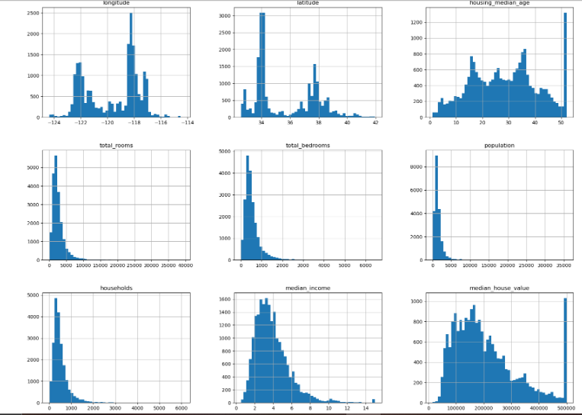
Distribution of Numeric Features in the Housing Dataset
Notes:
total_rooms, total_bedrooms, and population are heavily right-skewed, indicating this suggests areas with extremely high populations or large buildings. median_income shows a right-skewed distribution but has a noticeable peak. Most incomes are concentrated between 2 and 6 (scaled). median_house_value shows a clear ceiling effect at $500,001, where many observations are concentrated.This indicates that the data has been censored, which may affect model performance since we cannot accurately model values above this threshold. The housing_median_age histogram has a fairly uniform distribution, with a peak near the maximum value (52 years).This suggests many homes are older and likely built in similar time periods, with fewer newer properties. longitude and latitude show clusters, indicating specific geographic regions dominate the dataset.These clusters likely represent major population centers. Most households fall within a smaller range, while a few have very large household counts.

Slide 7
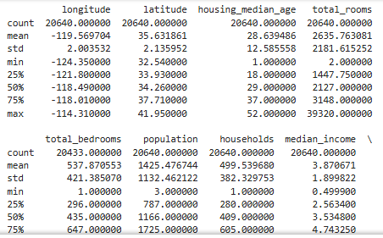
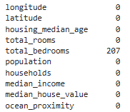
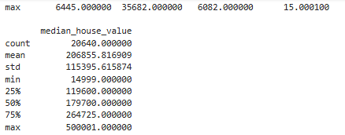
Initial Dataset Exploration

Slide 8
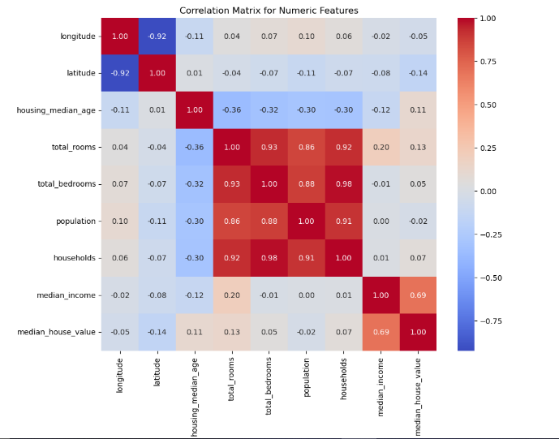
Correlation Matrix for Numeric Features

Slide 9
Data Preparation and Preprocessing Setup
Feature Selection:
Defining the independent variables (X) and the target variable (y).
Dataset Splitting:
Splitting the dataset into training and testing subsets.
Preprocessing Pipeline Setup:
Identifying numeric and categorical features.
Defining pipelines for handling missing values, scaling numeric features, and encoding categorical features.

Slide 10
Model Integration and Training
This part focuses on integrating the preprocessing with the model
and fitting it to the training data:
Creates a Unified Pipeline:
Combines the preprocessing steps (preprocessor) with a regression model (LinearRegression).
Ensures preprocessing is applied consistently during both training and prediction.
Trains the Model:
Fits the LinearRegression model using the preprocessed training data (X_train and y_train).

Slide 11
Model Evaluation: Predictions and Metrics Calculation
Making Predictions:
The model (LinearRegression pipeline) is used to predict the target variable (median_house_value) for the test dataset (X_test).
Calculating Evaluation Metrics:
Mean Squared Error (MSE): Measures the average squared difference between actual and predicted values, indicating prediction accuracy.
R² Score: Explains the proportion of variance in the target variable that is predictable from the features.
Displaying Metrics: Outputs the calculated MSE and R² scores to assess model performance.
Mean Squared Error (MSE): 4908290571.346432
R² Score: 0.6254382675296266

Slide 12
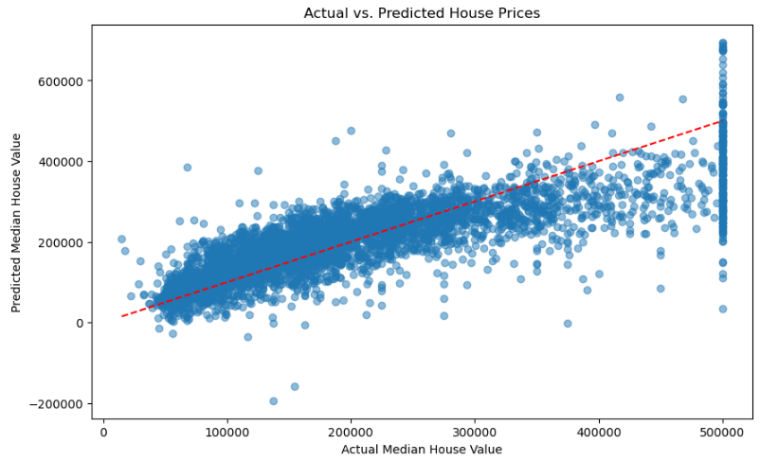
Visualization: Actual vs. Predicted Values

Slide 13
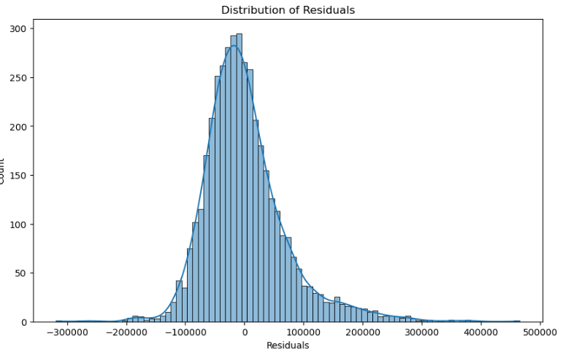
Visualization: Residuals Distribution

Slide 14
Pipeline Setup and Training: Random Forest Regressor
Pipeline Definition:
Combines the previously defined preprocessor with a RandomForestRegressor.
RandomForestRegressor is set with 100 estimators and a random_state=42 for reproducibility.
Model Training:
The pipeline is trained (fit) on the training dataset (X_train, y_train).
Preprocessing is applied to the training data before fitting the Random Forest model.
Purpose:
Incorporates feature scaling and encoding into the model training process.
Leverages Random Forest’s ability to handle complex, non-linear relationships in the data.

Slide 15
Evaluation: Random Forest Model Performance
Predictions:
The trained forest_model is used to predict the target variable (median_house_value) for the test dataset (X_test).
Evaluation Metrics:
Mean Squared Error (MSE): Measures the average squared difference between actual and predicted values. Lower values indicate better accuracy.
Mean Squared Error: 2395290032.473151
R² Score: Represents the proportion of variance in the target variable explained by the model. Higher values (closer to 1) indicate better fit.
R² Score : 0.8172104989933294

Slide 16
Cross-Validation for Random Forest Model Evaluation
Purpose:
Generalization Check: Ensures the model performs well across different subsets of the dataset.
Robustness: Helps detect overfitting by evaluating the model on multiple test subsets.
Cross-Validation:
The cross_val_score function splits the dataset into 5 folds (cv=5) and evaluates the model on each fold.
The metric used is the negative Mean Squared Error (neg_mean_squared_error), which is negated to report positive MSE values.
Average MSE:
The mean of the cross-validated MSE scores across all folds is calculated to assess the model's consistency and robustness.
Average MSE from cross-validation: 6040522361.014947

Slide 17
CONclusion
Data Exploration and Insights:
Distributions: Most numeric features (e.g., total_rooms, total_bedrooms, population, households) indicating areas with extreme housing characteristics, median_income is concentrated between 2 and 6, with very few high-income observations, median_house_value is capped at $500,001, indicating a ceiling effect in the data, which limits accurate prediction beyond this value.
Correlations: median_income shows a strong positive correlation (0.69) with median_house_value, making it the most influential predictor. Other features like total_rooms, total_bedrooms, and population show weaker correlations, suggesting multicollinearity or less direct influence on the target variable.
Insights: median_income is the most critical predictor for median_house_value, supported by the correlation matrix. Other features like total_rooms and total_bedrooms add value but show weaker correlations.
Model Performance
Linear Regression captures about 62.5% of the variance in median_house_value but struggles with non-linear patterns in the data, as indicated by the high residuals.
Random Forest significantly outperforms Linear Regression by capturing 81.7% of the variance and reducing the error by more than 50%. This highlights its strength in modeling non-linear relationships and interactions between features.
The cross-validation error is higher than the test-set MSE, suggesting some degree of overfitting in the Random Forest model.

Slide 18
References
https://stackoverflow.com/questions/60685866/how-do-i-find-out-the-rmse-of-a-random-forest-in-r
https://medium.com/ampersand-academy/random-forest-regression-using-python-sklearn-from-scratch-9ad7cf2ec2bb
https://www.kaggle.com/code/haseebwar07/random-forest-tuning-cross-validation
https://stackoverflow.com/questions/71615078/how-to-do-cross-validation-on-random-forest
https://www.kaggle.com/code/alexisbcook/pipelines
https://www.w3resource.com/python-exercises/pandas_numpy/pandas_numpy-exercise-11.php#google_vignette
https://www.geeksforgeeks.org/how-to-draw-2d-heatmap-using-matplotlib-in-python/

